Slide 1


Diversity, Equity and Inclusion
These copyrighted materials are the sole and exclusive property of Woolgar VanWiechen Cosgriffe Ducoffe LLP (“WVCD”). These materials are for the sole use of the person or entity to whom they were delivered by WVCD. No part of these materials may be reproduced or disclosed to any person without the express written consent of WVCD.

Slide 2
Agenda
What is Diversity, Equity and Inclusion?
Why is it important?
How to promote it in your workplace?
Conclusion

Slide 3
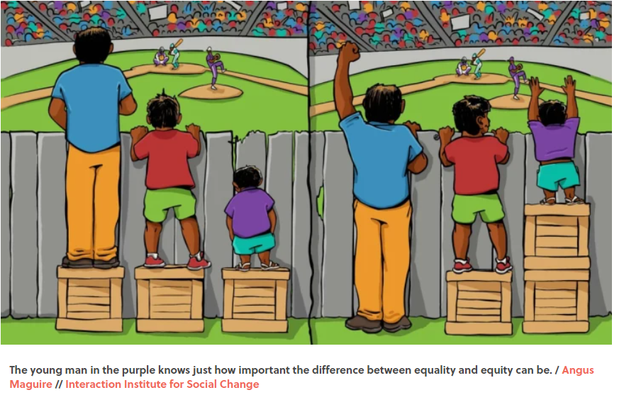
What is Diversity, Equity and Inclusion (DEI)?
Diversity: All the ways in which people differ.
Equity: Refers to the fair and respectful treatment of all people, taking into account fair outcomes for each individual.
Inclusion: Creating a welcoming work environment where everyone is respected and accepted.
Notes:
Diversity: Includes protected characteristics such as age, race, gender, ethnicity, mental and physical abilities, and sexual orientation. Extends to education, income, religion, work experience, language skills, geographic location, and family status.
Equity: Equity requires acknowledging and removing barriers have that historically impacted marginalized groups.
Inclusion: Inclusion provides a sense of belonging where everyone can thrive. Employees feel comfortable bringing their whole selves, their authentic selves to work.

Slide 4
Why is it important?
Legislation
Human Rights Code
Employment Equity Act
Accessibility for Ontarians with Disabilities Act (AODA)
Occupational Health & Safety Act (OHSA)

Slide 5
Human Rights Code
Human Rights legislation prohibits discrimination on a protected ground in a protected social area including employment.
Under The Code, the Employer must ensure the work environment is free from harassment and discrimination.
Notes:
Protected grounds:
Age
Ancestry, colour, race
Citizenship
Ethnic origin
Place of origin
Creed
Disability
Family status
Marital status (including single status)
Gender identity, gender expression
Record of offences (in employment only)
Sex (including pregnancy and breastfeeding)
Sexual orientation.

Slide 6
Employment Equity Act
Designed to overcome discrimination and increase employment of four designated groups:
Women
Indigenous Peoples
Persons with disabilities
Members of visible minorities
All federally regulated employers with 100 or more employees are subject to the Employment Equity Act.

Slide 7
Accessibility for Ontarians with Disabilities Act (AODA)
Mandatory for organizations to follow accessibility standards to become more accessible to people with disabilities.
The term “disability” covers a range of visible and invisible conditions that may have been present from birth, caused by an accident, or developed over time.
Employers are obligated to exercise due diligence to take every reasonable precaution to ensure a safe work environment to protect workers.
This includes protection against workplace violence and harassment.

Slide 8
Benefits of DEI
Competitive advantage to attract and retain diverse top talent.
Improves employee engagement, productivity and innovation.
Strengthens internal culture and external brand.
Promotes business growth.
Notes:
More than ever customers and job seekers are prioritizing companies and employers that align with their beliefs and core values.

Slide 9
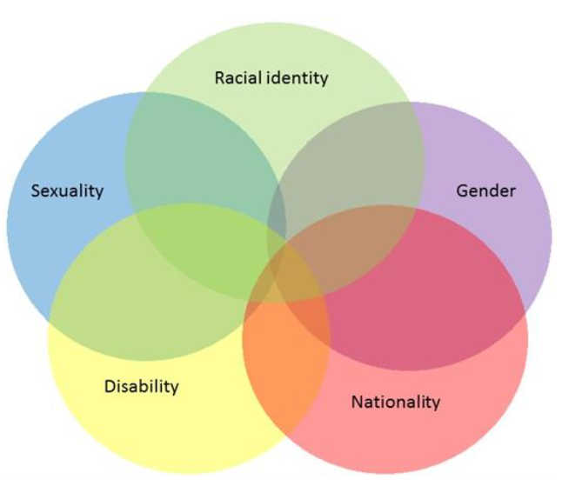
Keep in mind…
Intersectionality
Implicit Bias
Microaggressions
Notes:
Intersectionality - A framework, coined by Black Feminist Legal Scholar Kimberlé Crenshaw in 1989, to describe how multiple social categories or identities such as race, gender, sexuality, disabilities, can intersect with one another.
Implicit Bias - Also known as unconscious bias, these are attitudes and stereotypes that we associate with certain people or groups. These influence our decision-making processes and behaviour without us being aware of them.
Microaggressions - These are subtle or indirect questions, remarks, actions or incidents that are discriminatory against members of a marginalized group.

Slide 10
How to promote DEI in the workplace?
Tailor a DEI strategy tied to your vision, mission and values.
Seek input, feedback and advice internally and externally.
Encourage Employee Resource Groups (ERGs).
Continuously assess your DEI program.
Inclusive Leadership.
Policies.
Ongoing training and education.
Notes:
Tailor a DEI strategy to suit your company and continuously assess your DEI program.
This is not a ‘one and done’ approach. DEI requires monitoring, assessing and modifying processes as time goes on.
This will require strategic planning to determine your strategy - how will you bring this to life? This will allow you to set your direction and make decisions on how you’ll dedicate resources for this strategy.
Check in internally and externally
Internally from different departments, functions, lines of businesses – encourage participation from all employees
Externally from community groups and community champions to take a holistic view of the groups you seek to engage with
Employee Resource Groups (ERGs)
Voluntary, employee-led groups based on shared interests, characteristics, backgrounds or demographic factors such as gender, race, ethnicity, religious affiliation
Inclusive Leadership
Leaders set the tone from the top when it comes to DEI
Have diverse representation on your leadership team
Devise policies – relevant best practices and compliance policies
Consider developing a DEI policy in light of growing legal requirements and social expectations
Review and develop policies and procedures – formulate a DEI lens framework with which to review and reevaluate your policies, practices and decision-making processes to identity and eliminate systemic barriers and incorporate diversity and inclusion considerations.
Accommodation policy
Diversity Statement
Code of Conduct
Health and Safety Policy
Respect in the workplace policy
Pay Equity
Ongoing training and education
Invest in training throughout your organization from entry level staff to C-level executives.
Train those directly involved in the hiring process.

Slide 11
Recruiting & Hiring for Diversity
Establish specific goals for recruitment from underrepresented groups
Review job descriptions and job postings through an inclusive lens
Ensure inclusive recruitment practices
Comply with Human Rights Legislation
Provide Accommodation where required
Track DEI metrics

Slide 12
Conclusion
Examine your existing culture.
Set a course for a DEI Strategy to eliminate biases.
Comply with Legislation.
Review and develop policies and procedures that are inclusive.
Provide on-going training & education throughout your organization.
Monitor and re-assess your DEI strategy periodically.
Gather and analyze insights from DEI metrics.

Slide 13


Thank you
e2r™
70 The Esplanade, Suite 401
Toronto, ON M5E 1R2
clientcare@e2rsolutions.com
Thank you!

